Slide 1
Deep Learning networks
Jian Yang
Jun 27, 2017

Slide 2
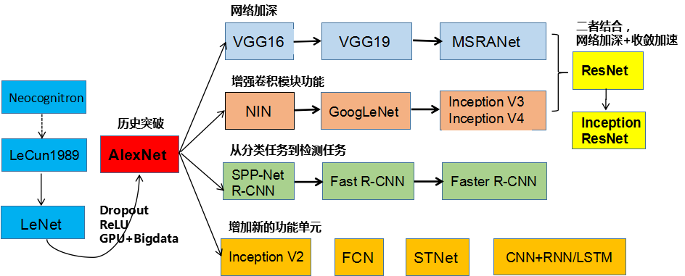
Development history
Notes:
From : http://blog.csdn.net/cyh_24/article/details/51440344

Slide 3
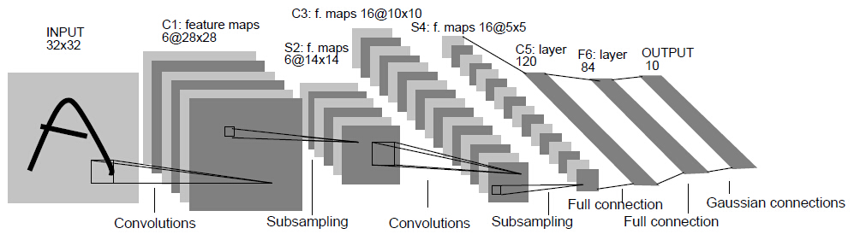
LeNET
Parameters
C1: (Filter 5x5 +1 Bias )x 1in x 6 out features = 156
C3: (Filter 5x5 +1 Bias)x 6in x 16 out features = 2496
C5: (Filter 5x5 +1 Bias)x 16in x 120 out features = 49920
F6: (1 + bias) x 120 In * 84 out = 20160
F7: (1 + bias) x 84 In * 10 out = 1680

Slide 4
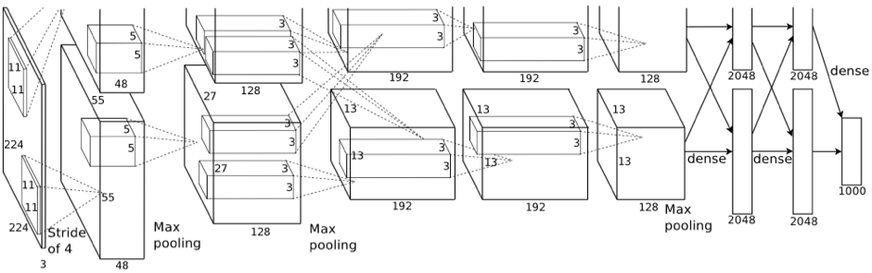
AlexneT
Parameters
~ 115M
~or 460 M in 32bits float
Notes:
Layer 1:
Input = 224x224x3
Stride = 4;
Feature Maps = 96
Output Size = 55x55
Filter Size = 11x11
Conv1: = (11*11 filter+ 1 bias) * 96 * 3 = 35136
RelU1: f(x)=max(0,x)
Norm 1:
Pooling 1:
Layer 2: Cov2:
( 5 * 5 filter+ 1 bias) * 96 * 256 = 63879
Layer3 : (3x3 +1) * 256 * 384 =983040
Layer 4: (3x3 +1) * 384* 256 = 983040
Layer 5: (3x3 +1) * 256* 256 = 655360
FC6: 6x6 * 256 Maps → 4096 = 6*6 * 256 * 4096 * 2 = 75497472
FC7: 4096 * 4096 * 2 = 33554432
FC8: 4096 * 1000 * 2= 8192000

Slide 5
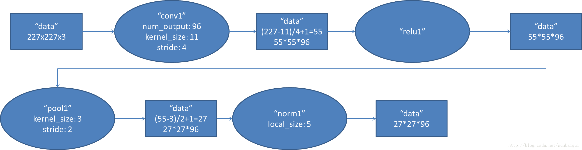
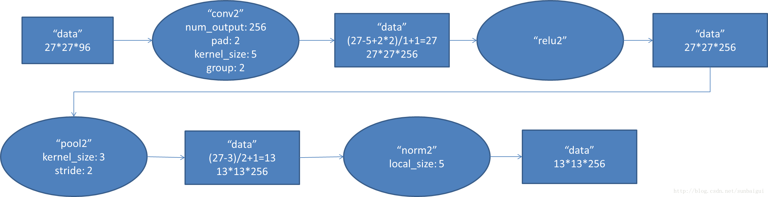

Slide 6
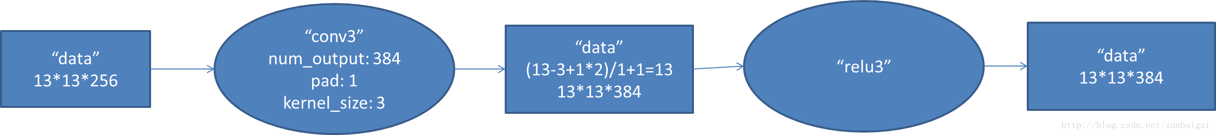
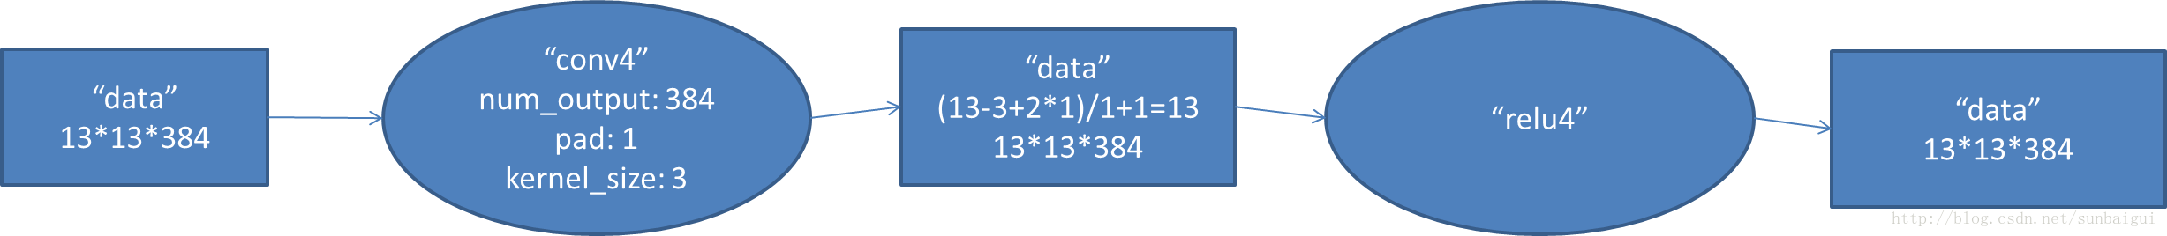
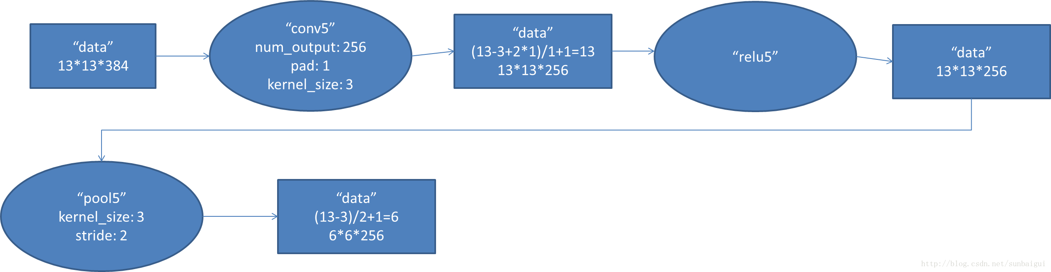

Slide 7
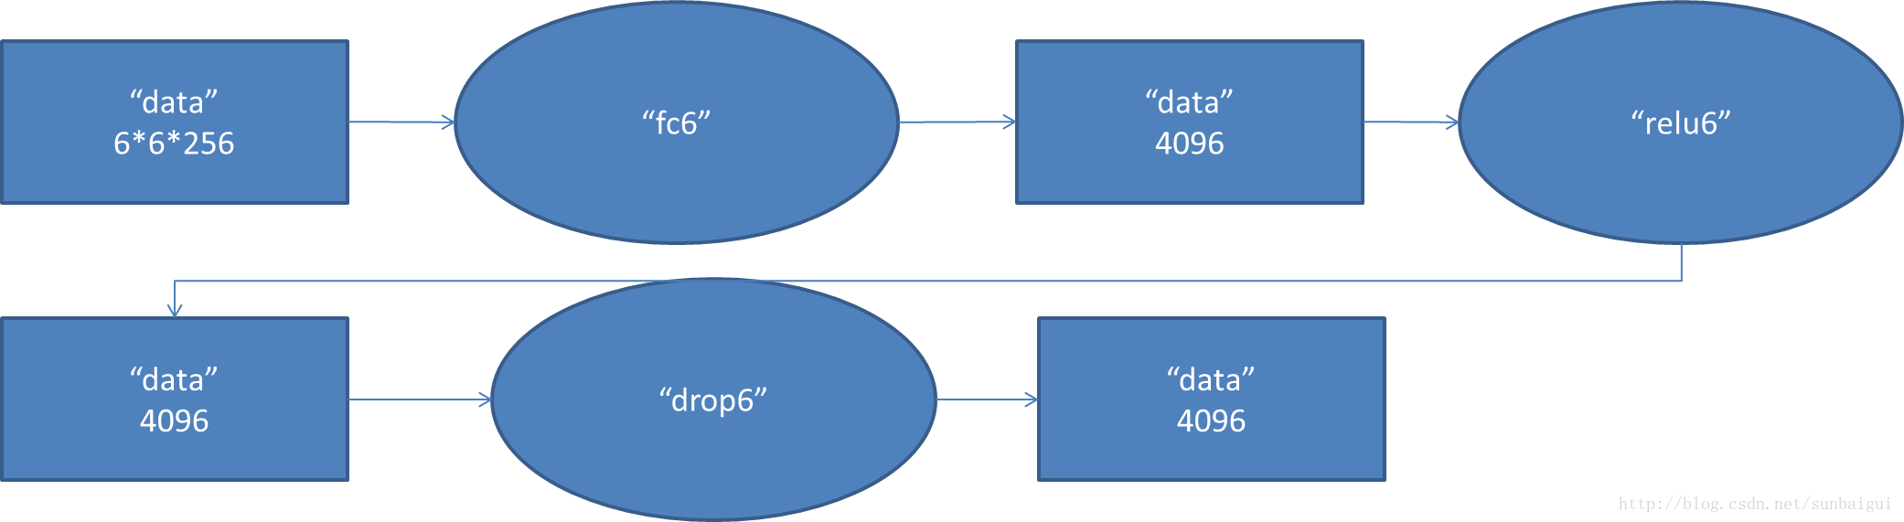
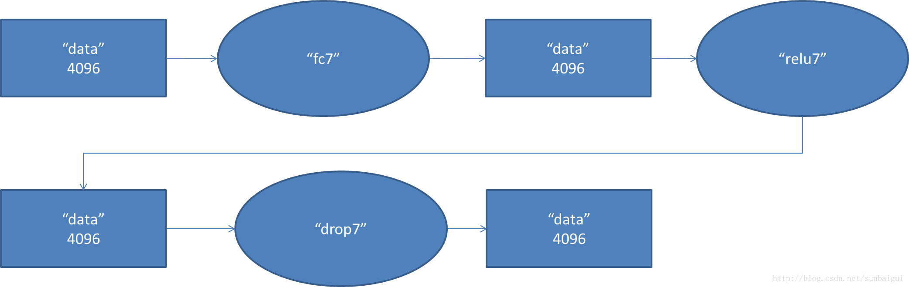
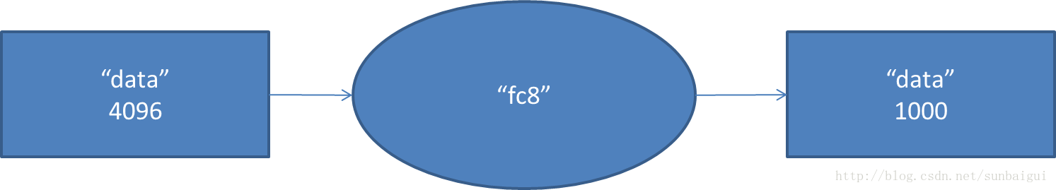

Slide 8
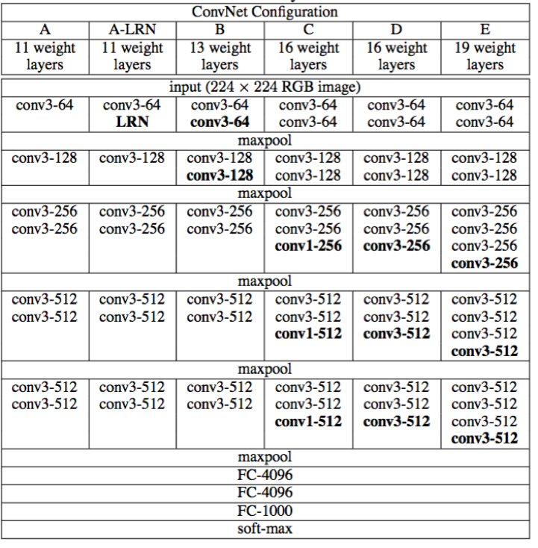
VGG

Slide 9
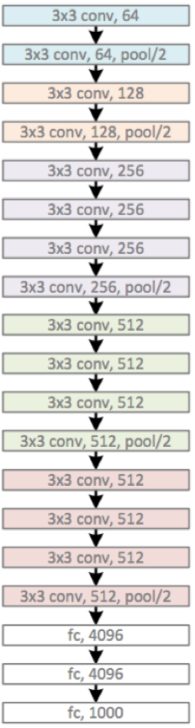
VGG-19

Slide 10
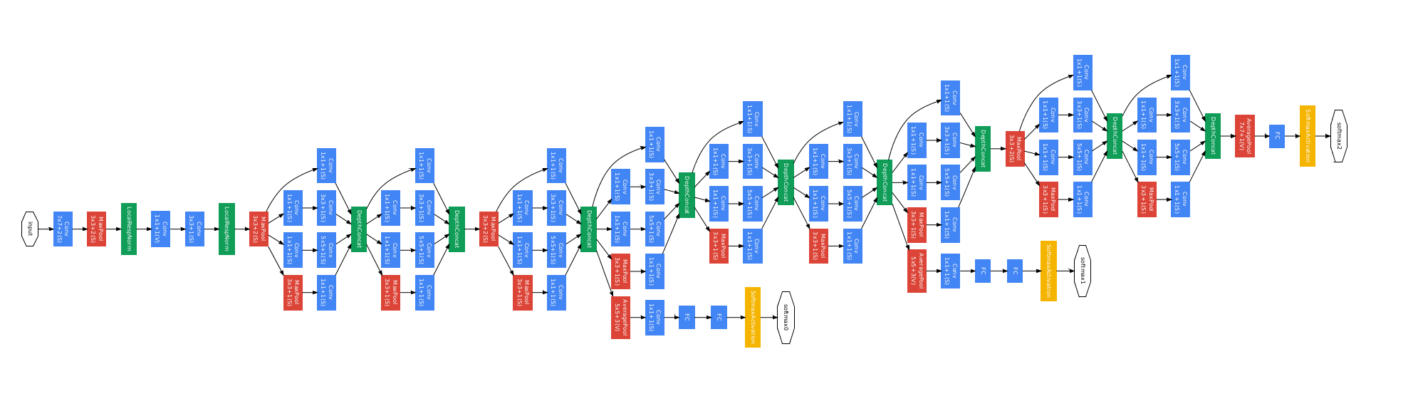
GoogleNet

Slide 11
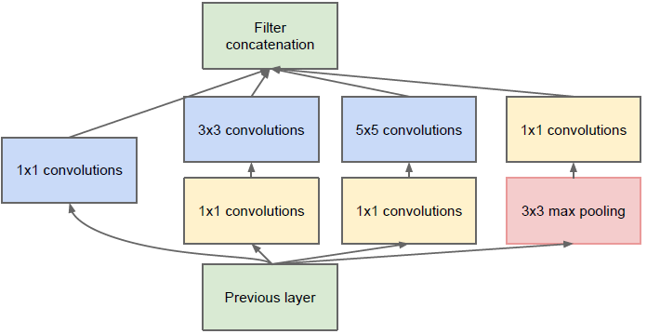

Slide 12
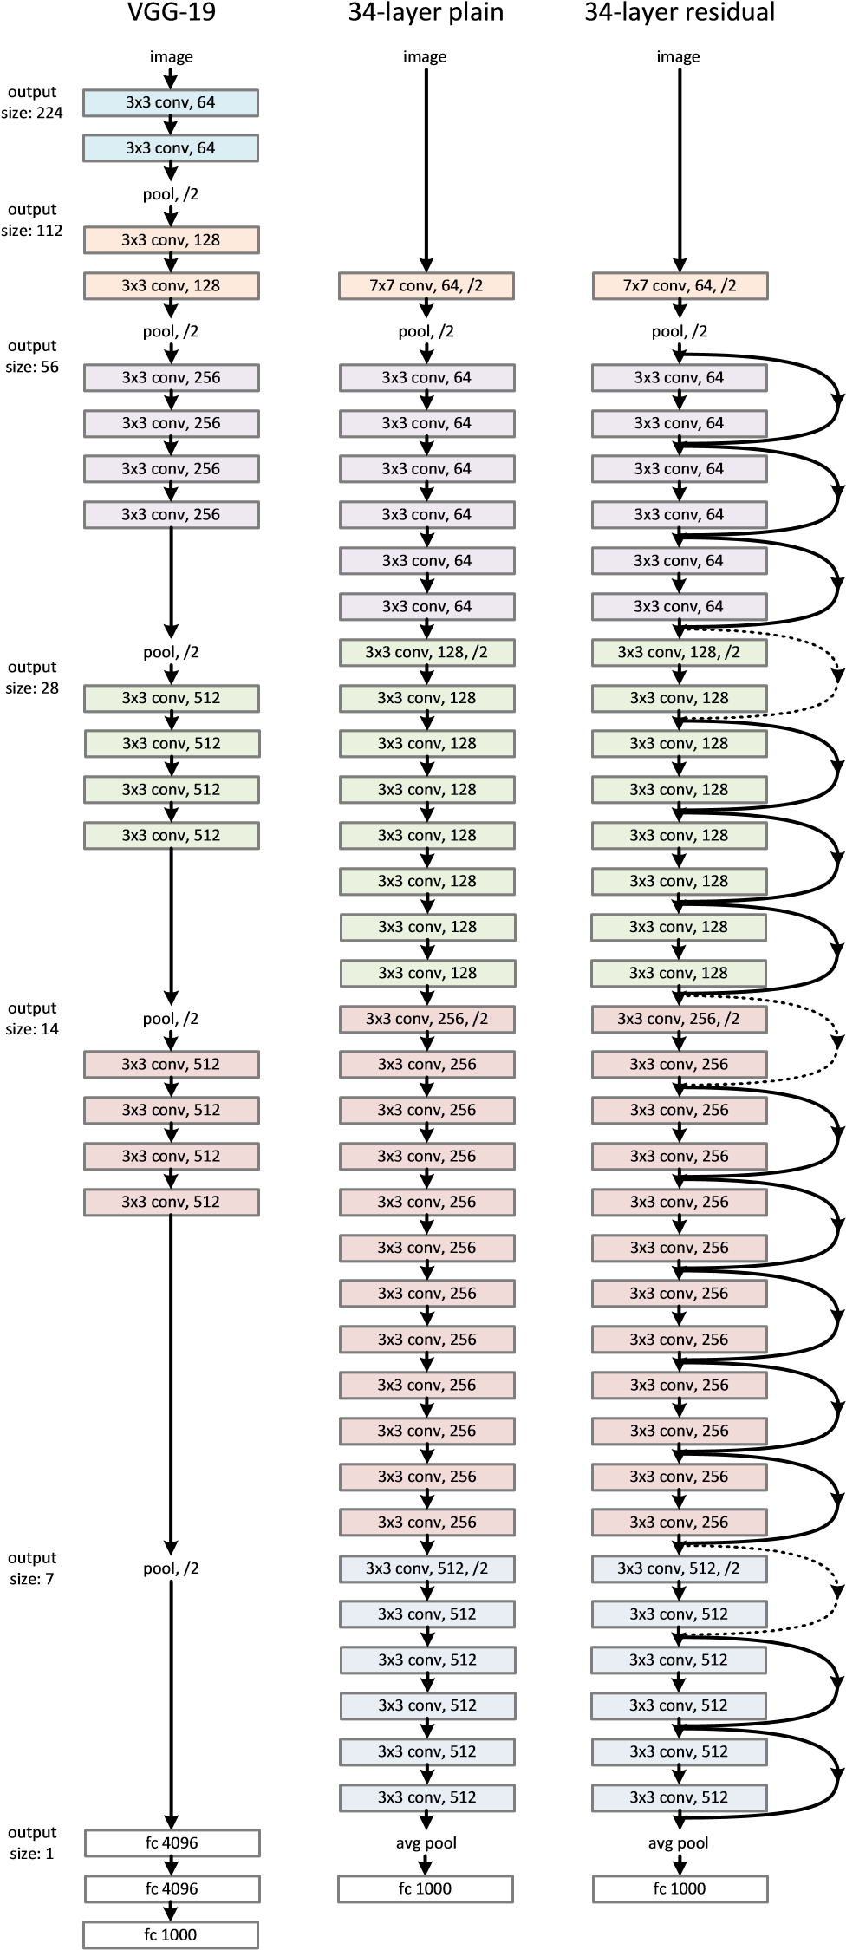
Resnet

Slide 13
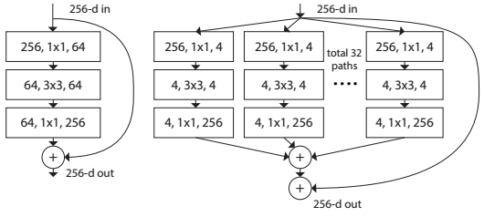
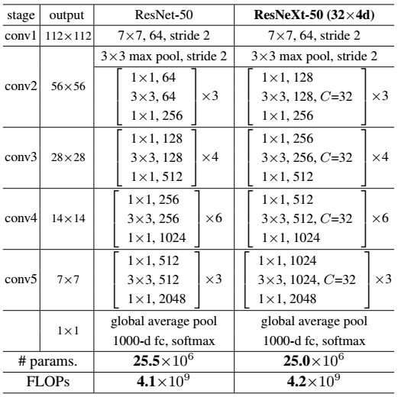
ResnetXT
Notes:
https://arxiv.org/abs/1611.05431
https://github.com/antingshen/resnet-protofiles
Resnet-18
Resnet-34
Resnet-50
Resnet-101
Resnet-152
Resnet-200
https://github.com/facebook/fb.resnet.torch/tree/master/pretrained

Slide 14
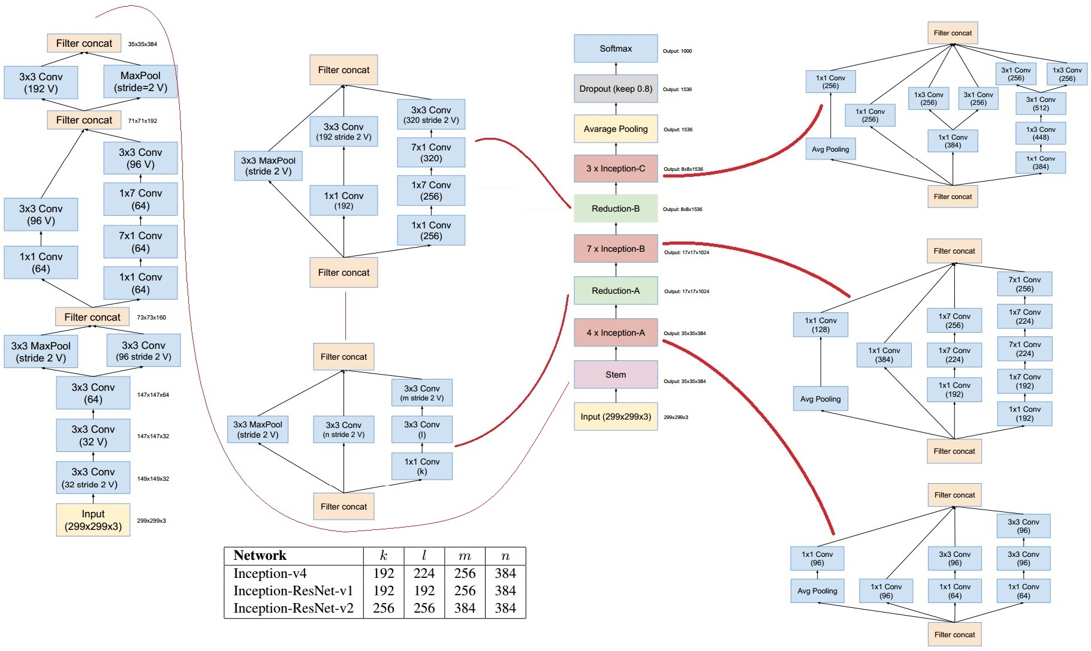
Google interception V4
Notes:
https://arxiv.org/abs/1602.07261
Detailed Chart: https://github.com/titu1994/Inception-v4

Slide 15
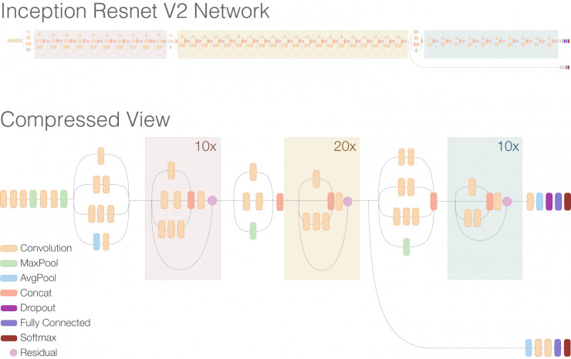

Slide 16
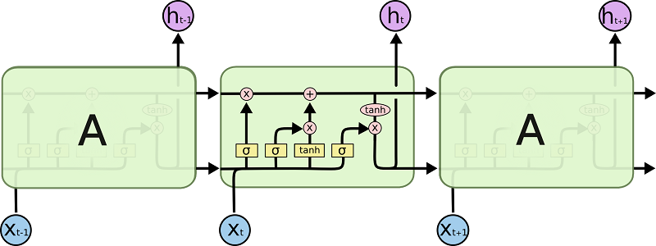
RNN: https://github.com/Element-Research/rnn

Slide 17
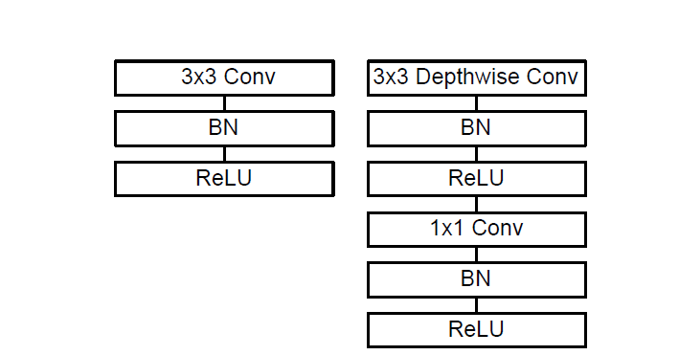
Mobilenets
Type / Stride | Filter Shape | Input Size
Conv / s2 | 3×3×3×32 | 224×224×3
Conv dw / s1 | 3×3×32 dw | 112×112×32
Conv / s1 | 1×1×32×64 | 112×112×32
Conv dw / s2 | 3×3×64 dw | 112×112×64
Conv / s1 | 1×1×64×128 | 56×56×64
Conv dw / s1 | 3×3×128 dw | 56×56×128
Conv / s1 | 1×1×128×128 | 56×56×128
Conv dw / s2 | 3×3×128 dw | 56×56×128
Conv / s1 | 1×1×128×256 | 28×28×128
Conv dw / s1 | 3×3×256 dw | 28×28×256
Conv / s1 | 1×1×256×256 | 28×28×256
Conv dw / s2 | 3×3×256 dw | 28×28×256
Conv / s1 | 1×1×256×512 | 14×14×256
Conv dw / s1 5× Conv / s1 | 3×3×512 dw 1×1×512×512 | 14×14×512 14×14×512
Conv dw / s2 | 3×3×512 dw | 14×14×512
Conv / s1 | 1×1×512×1024 | 7×7×512
Conv dw / s2 | 3×3×1024 dw | 7×7×1024
Conv / s1 | 1×1×1024×1024 | 7×7×1024
Avg Pool / s1 | Pool 7×7 | 7×7×1024
FC / s1 | 1024×1000 | 1×1×1024
Softmax / s1 | Classifier | 1×1×1000
3x3 Conv
BN
ReLU
3x3 DepthWise Conv
BN
ReLU
1x1 Conv
BN
ReLU
Notes:
https://arxiv.org/pdf/1704.04861.pdf

Slide 18
Very Deep Super Resolution

Slide 19
Persistent RNN

Slide 21
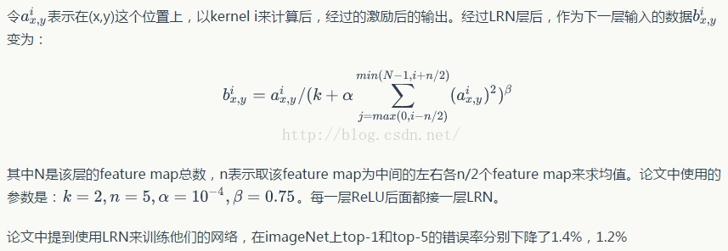
LRN（Local Response Normalization）
神经网络初学者，没有什么理论基础，偶然看到个ImageNet，就准备从其入手，先弄懂每层的含义，其中这个LRN层真是让人百思不得其解，搜索了下，给出的介绍比较少。为什么会比较少呢，搜索到最后我得出的结论是，这货似乎没什么多少卵用。。。 ImageNet中的LRN层是按下述公式计算的：
但似乎，在后来的设计中，这一层已经被其它种的Regularization技术，如drop out, batch normalization取代了。知道了这些，似乎也可以不那么纠结这个LRN了。
http://cs231n.github.io/convolutional-networks/ 是关于CNN的一篇很好的介绍。

